Slide 1
1600-1700’s
British and French rivalry or natural resources in North America.
With a partner, list the natural resources they would be fighting over.

Slide 2
Resources
Maritimes: cod (fishing)
Quebec: fur trade
3 F’s – Fish, Fur, Forest
What do you see in the photo?
What does it tell us about trade between Aboriginal peoples and Europeans?

Slide 3
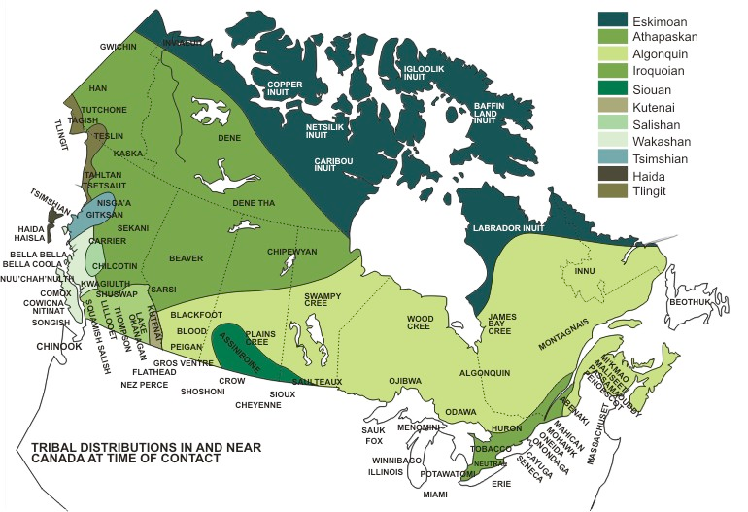

Slide 4
War of 1812
Causes?
1) Britain angered USA with their policies
2) USA wanted to expand their territory (manifest destiny)
Winners?
Effect for CANADA: solidifies our borders and helps Loyalists in Upper gain sense of identity as a unified nation.

Slide 5
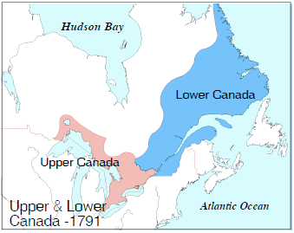
Background: Constitutional Act of 1791
Britain split the colony of Quebec into Upper + Lower Canada
 | Upper Canada | Lower Canada
Location | red | blue
Language | English | French
Religion | Anglican Church | Catholic Church
Population | 14,000 | 100,000

Slide 6
Why did people come to Canada?
USA Revolution – brings L_______________ to Canada
After the War of 1812, do you think American settlers were welcome in Upper/Lower Canada?!

Slide 7
Who came to Canada?
1815 - 80% immigrants in Upper Canada = American born Loyalists
1840 – 50% immigrants are recent
British immigrants

Slide 8
The Great Migration
1815-1850
Huge influx of immigrants to North America (5 million) from
England, Scotland, Ireland, Wales
(later Germany and Scandinavia)

